Slide 1

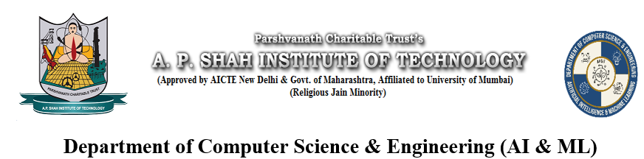
Virtual Mouse by Gesture Recognition
Chavez Anthony - 22106038
Sumeet Gupta - 22106091
Mohammed Ali Bardi - 22106058
Kshitij Chitnis - 22106078
Project Guide-
Prof.Ranjita Asati

Slide 2
Outline
Introduction
Literature Survey of the Existing Systems
Limitations of the Existing Systems
Problem Statement
Proposed System Design
Framework/Algorithm
Technologies Stack for Proposed System
Details of Database / Input to the System
Implementation(Partial)
Conclusion
References

Slide 3
Introduction
Real-time virtual mouse control using gesture recognition aims to replace traditional input devices with intuitive hand movements. This technology enables users to interact with their computers or devices by simply moving their hands in the air.
Problems include challenges with accuracy, latency, environmental interference, and variability among users.
Current solutions involve advanced sensors, machine learning algorithms, and user calibration to address these issues. However, persistent issues such as handling complex gestures, adapting to diverse real-world conditions, and managing high processing demands still need improvement.

Slide 4
Literature Survey
[1]"Virtual Mouse using Hand Gestures", Roshni Matlani & Roshan Dadlani, IEEE, 2022.
Gesture-controlled laptops and computers have recently gained a lot of traction. Leap motion is the name for this technique. Waving our hand in front of our computer/laptop allows us to manage certain of its functionalities. Over slides and overheads, computer-based presentations have significant advantages. Audio, video, and even interactive programmes can be used to improve presentations. Unfortunately, employing these techniques is more complicated than using slides or overheads.
[2]"A Survey Paper on Hand Gesture Recognition", Bhumika Nandwana & Satyanarayan Tazi, IEEE, 2020.
Hand gesture recognition system has a good attention now days because of easy interaction between human and machine. The focus of developing hand gesture is to create a better communication between human and computer for conveying information. This paper presents a survey on recent technology of hand gesture recognition both static and dynamic. It shows all method that was used for hand gesture recognition in different research paper.

Slide 5
[3]"Gesture Recognition Using Optical and Acoustic Sensors", Hirose M. & Saito H., IEEE, 1985.
This early work laid the groundwork for gesture recognition technology by exploring the use of optical and acoustic sensors to detect and interpret hand movements. Their research provided foundational concepts for gesture-based control, marking the beginning of systematic studies in this area.
[4]"High-Precision Hand Tracking with Leap Motion: A Study on Gesture Recognition", Williams, S. A. & Patel, A. B., IEEE, 2014.
Williams and Patel explored Leap Motion’s high-precision hand tracking capabilities, demonstrating its effectiveness in providing accurate and responsive gesture recognition. Their study illustrated the advancement in gesture recognition technology with Leap Motion’s introduction.

Slide 6



Isuues of Gesture-based Input
Accuracy
Achieving reliable and accurate gesture recognition remains a challenge, especially in complex environments.
Latency
Real-time responsiveness is crucial, but processing hand gestures can introduce latency issues.
Segmentation
Accurately segmenting the hand from the background can be difficult, especially in cluttered environments.

Slide 7
Problem statement
Despite advancements in gesture recognition technology, accurately and reliably controlling a virtual mouse through hand gestures remains a significant challenge. The primary issues include accuracy, latency, and environmental adaptability.We have developed a project to overcome these issues.

Slide 8
Proposed System Design
INPUT FROM WEBCAM
USING VIDEO CAPTURE
HANDTRACKING USING FINDHANDS AND
FINDPOSITION
START
VISUAL DISPLAY AND
FEEDBACK
VOLUME CONTROL LOGIC
MOUSE POINTER PLACEMENT
LOGIC
END
DISTANCE CALCULATION
CO-ORDIINATES
CALCULATION
VOLUME MAPPING
AND ADJUSTMENT
POINTER
PLACEMNET

Slide 9
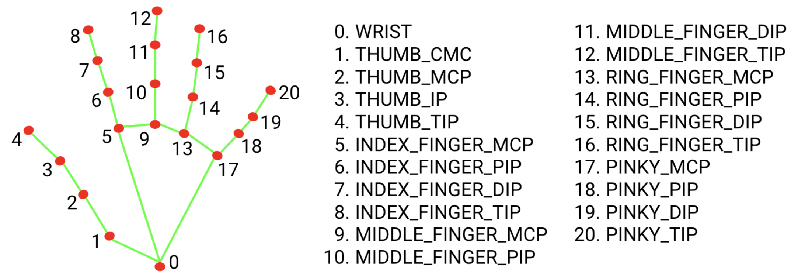
Framework/Algorithm
Mediapipe Models:
The Hand Landmarker uses a model bundle with two packaged models: a palm detection model and a hand landmarks detection model.
The hand landmark model bundle detects the keypoint localization of 21 hand-knuckle coordinates within the detected hand regions. The model was trained on approximately 30K real-world images, as well as several rendered synthetic hand models imposed over various backgrounds.
Figure 1. hand landmarker model

Slide 10
Technology Stack for Proposed System
Python
Python is a high-level, general-purpose programming language. Its design philosophy emphasizes code readability with the use of significant indentation.
OpenCV
Open-source computer vision library for real-time image/video processing.
Mediapipe
Open-source machine learning framework for building multimodal applied ML pipelines.

Slide 11
OpenCV's cv2.VideoCapture() function is used to capture the live video feed from the webcam. This provides the continuous stream of image frames that are processed by the system.
Input to the System
The input to the system is a live video stream captured from a webcam. This video feed provides the system with real-time images of the user's hand, which are then processed for hand detection and gesture recognition . Specifically, the input is a continuous sequence of image frames that the system analyzes to detect hand landmarks and calculate the distance between specific fingers .
OpenCV's cv2.VideoCapture() function is used to capture the live video feed from the webcam. This provides the continuous stream of image frames that are processed by the system.

Slide 12
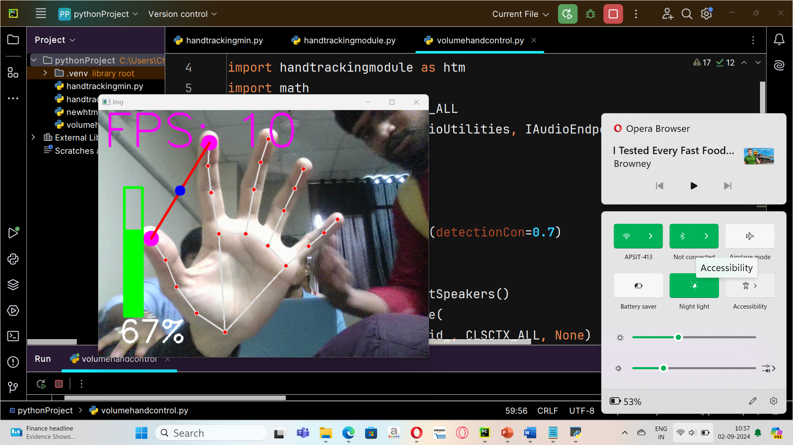
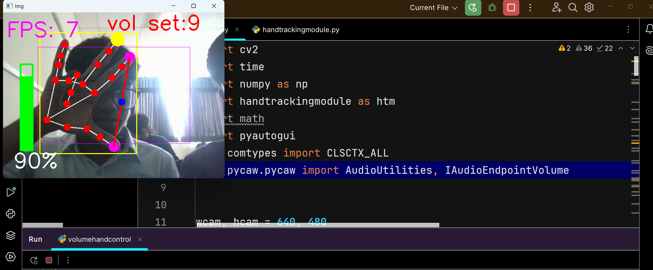
Figure 2. volume control implementation
Implementation
Figure 2. volume control implementation
Figure 3. virtual mouse

Slide 13
Conclusion
Gesture recognition technology, when applied to volume control and virtual mouse systems, offers a hands-free, intuitive, and efficient way to interact with devices. This technology can significantly enhance user experience by enabling natural movements to replace traditional input methods. For volume control, gestures can allow for quick and precise adjustments without the need to physically interact with the device. As for virtual mouse functionality, gestures provide a more dynamic and versatile method of navigation, particularly in environments where physical input devices are impractical or undesirable.

Slide 14
References
[1]"Virtual Mouse using Hand Gestures", Roshni Matlani & Roshan Dadlani, IEEE, 2022.
[2]"A Survey Paper on Hand Gesture Recognition", Bhumika Nandwana & Satyanarayan Tazi, IEEE, 2020.
[3]"Gesture Recognition Using Optical and Acoustic Sensors", Hirose M. & Saito H., IEEE, 1985.
[4]"High-Precision Hand Tracking with Leap Motion: A Study on Gesture Recognition", Williams, S. A. & Patel, A. B., IEEE, 2014.

